Slide 1
ADD A DATABASE to your .NET application
Adding Seed Data to your application

Slide 2
Nugget packages
Add Microsoft.EntityFrameworkCore.SqlServer
Add Microsoft.EntityFrameworkCore.Design
Add Microsoft.EntityFrameworkCore.Tools

Slide 3
Objects that are used within the project are refured to as Models. These models represent how your database looks like.
Models are placed in Solution -> Project -> Models (add this folder)

Slide 4
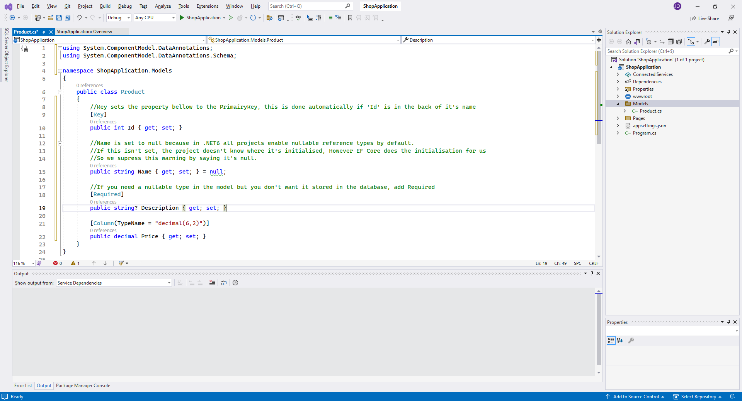
Models are standard a normal Class

Slide 5
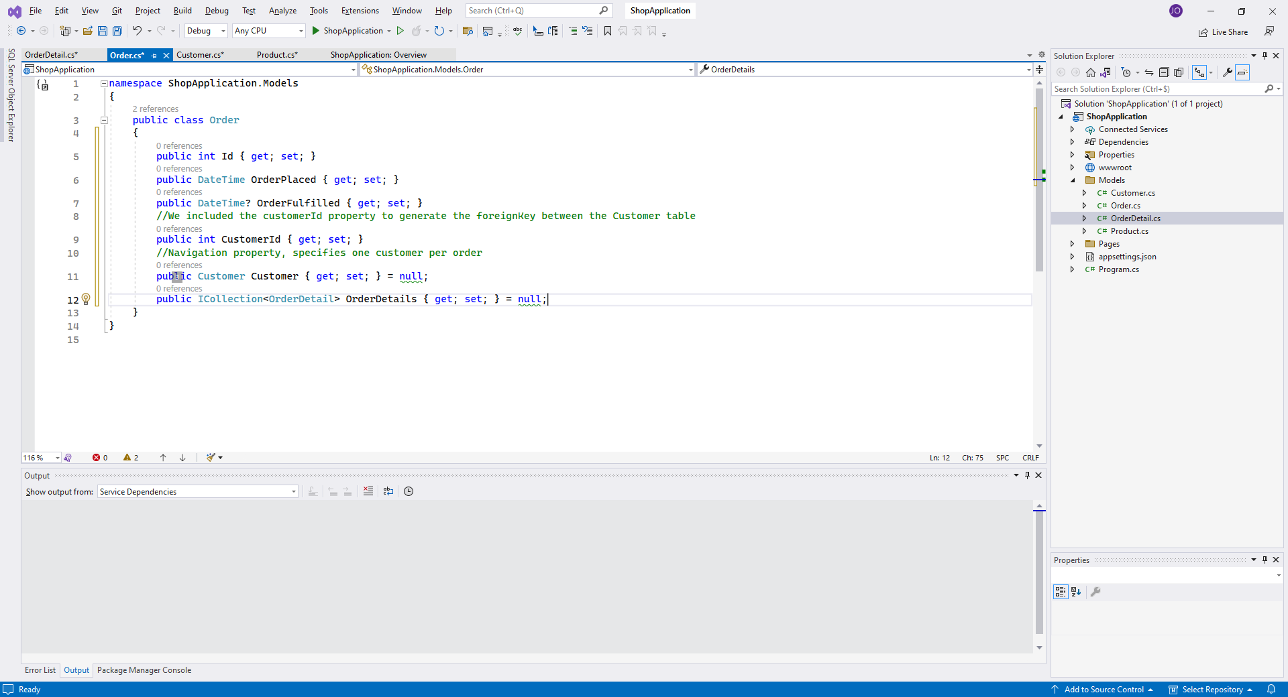
Add additional models/tables and add the foreignKey’s

Slide 6
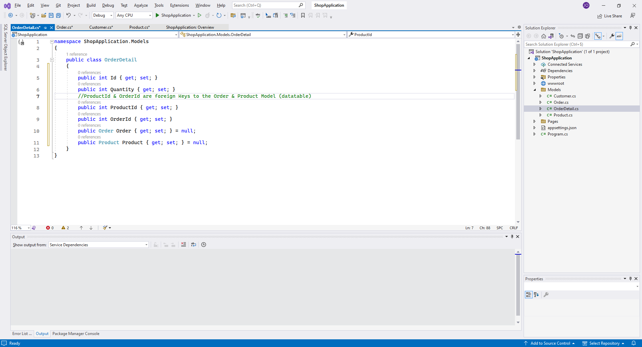
Add additional models/tables and add the foreignKey’s

Slide 7
Add the Data folder in Solution -> Project -> Data (create this folder)
Add the class NAMEDbContext.cs (ProductDbContext.cs for example)

Slide 8
Add the Data folder in Solution -> Project -> Data (create this folder)
Add the class NAMEDbContext.cs (ProductDbContext.cs for example)

Slide 9
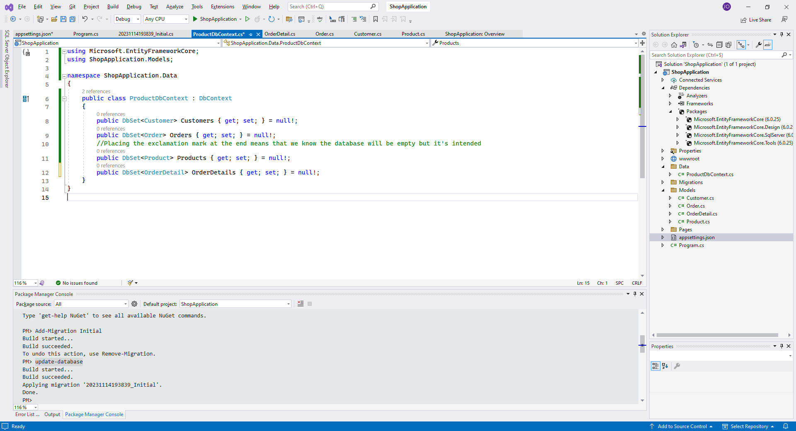
ProductDbContext inherits from DbContext
Each DbSet matches a table that will be created in the database

Slide 10
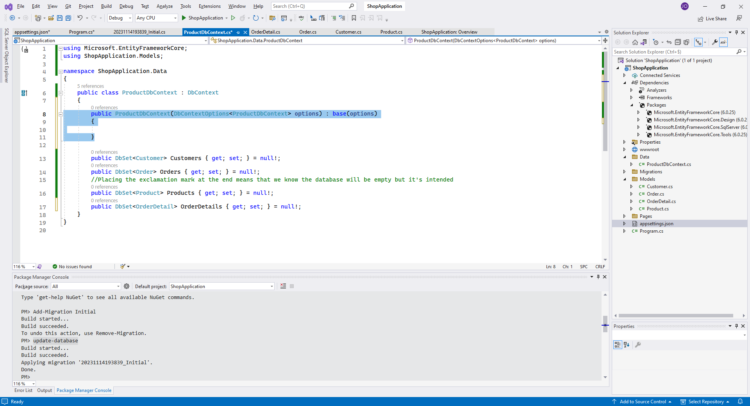
We add the constructor that takes ‘DbContextOptions<ProductDbContext>’ as a parameter this is how we can modify the details of the DB in program.cs

Slide 11
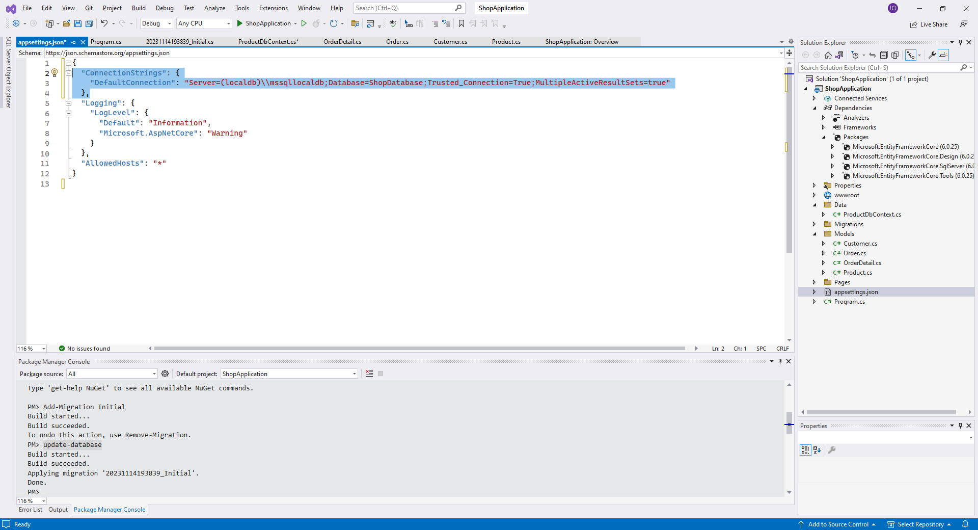
We open appsettings.json and add a connectionstring
The connectionstring here is named DefaultConnection

Slide 12
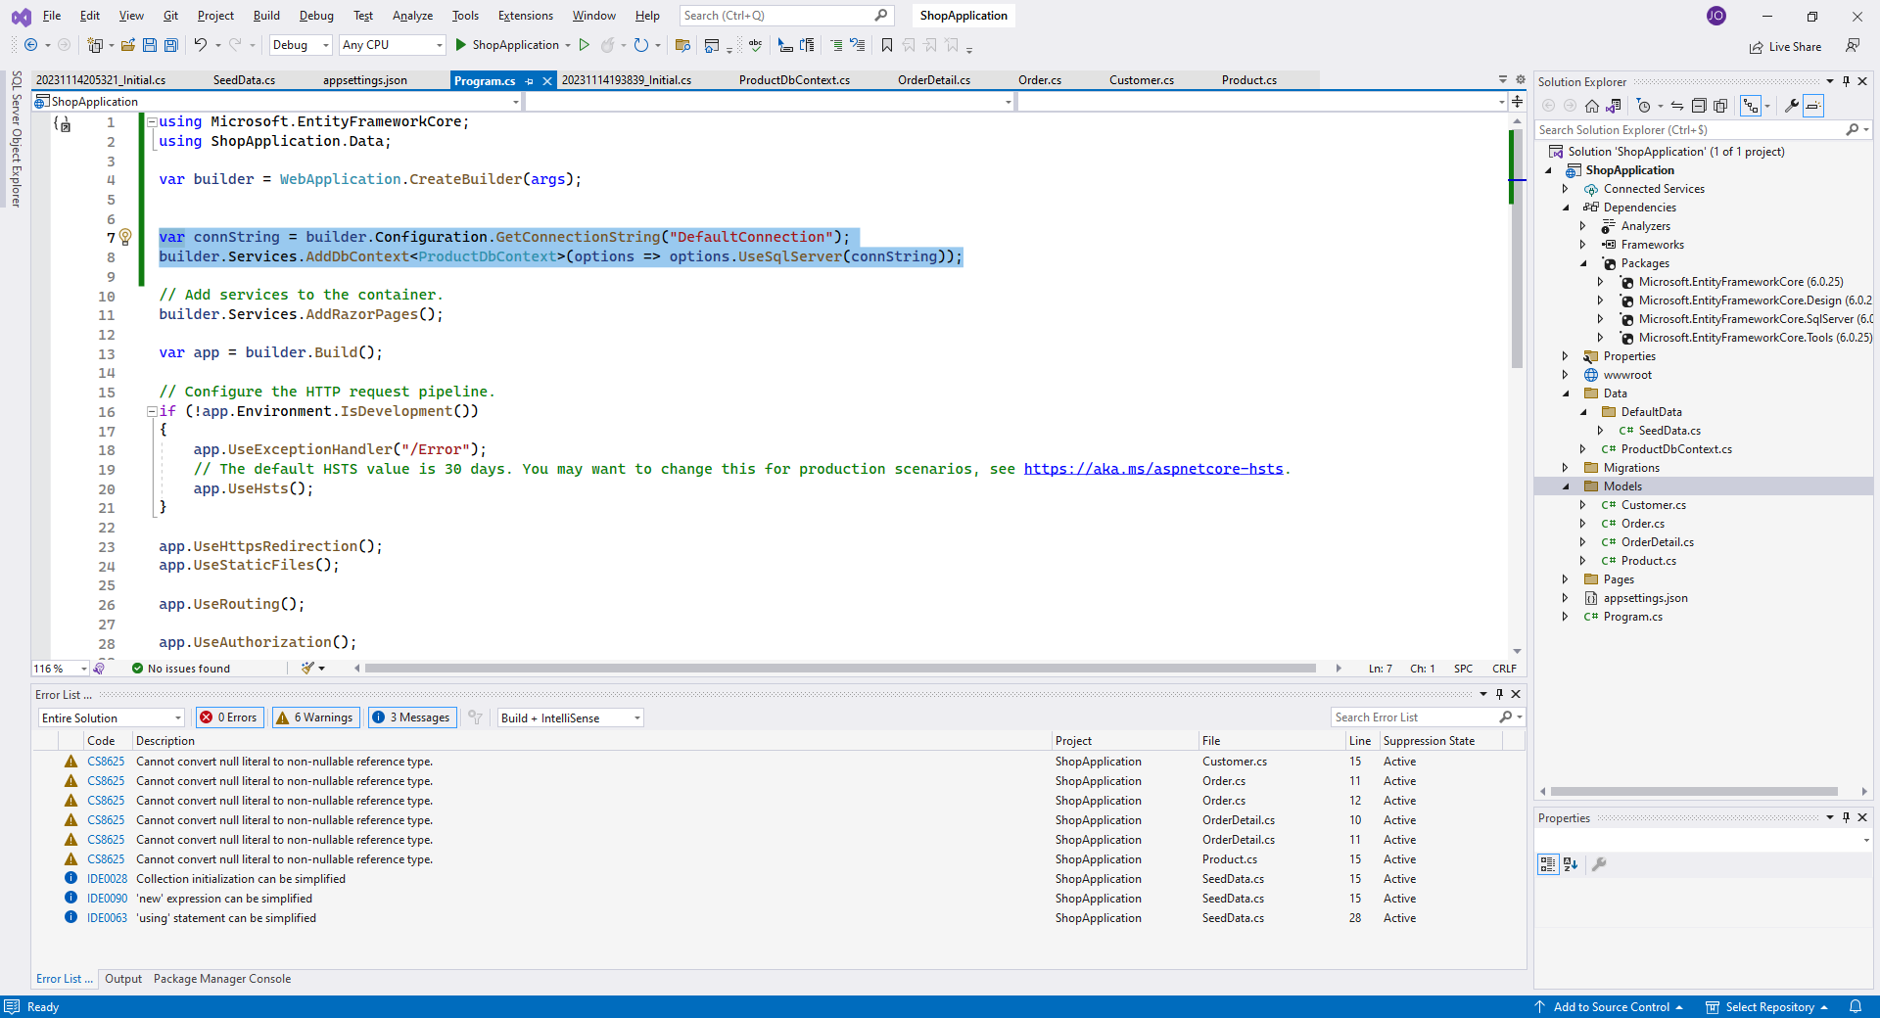
Below ‘var builder’ we add this line, it says to ge the connection from ProductDbContext, we add this as a service. Make sure that the string in GetConnectionString is equal to the name you gave it.

Slide 13
Now we migrate our database by opening Package Manger Console
Tools -> NuGet Package Manager -> Package Manager Console
Typ -> “ Add-Migration Initial “

Slide 14
If by any chance the migration has errors look if you already have a Migrations folder in your solution and delete it, then try again
If this doesn’t work try using Remove-Migration
If this still doesn’t work rename your database you created in slide 9

Slide 15
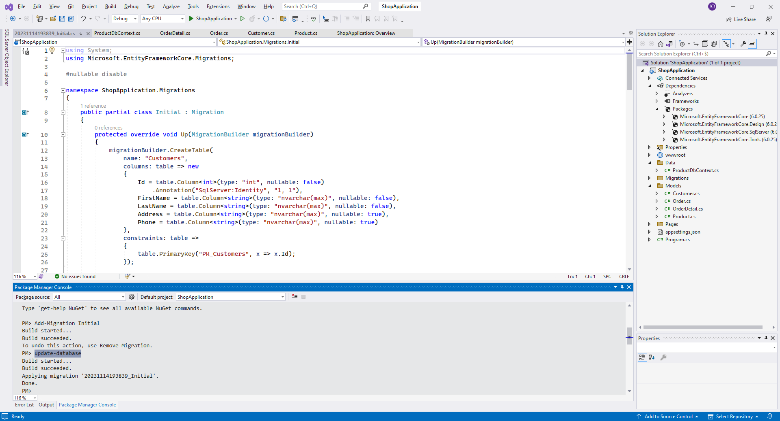
Next we type in the command “ Update-Database “
If this doesn’t work try using “ Drop-Database “
Note: if you modify a model type “Add-Migration (type what changed)” and also “ Update-Database “

Slide 16
To view what’s in the database go to View -> SQL Server Object Explorer.

Slide 17
In our Data folder create a new folder named “DefaultData” and create a class “SeedData” this is a public STATIC class.
It is static so we can get properties from here without a constructor

Slide 18
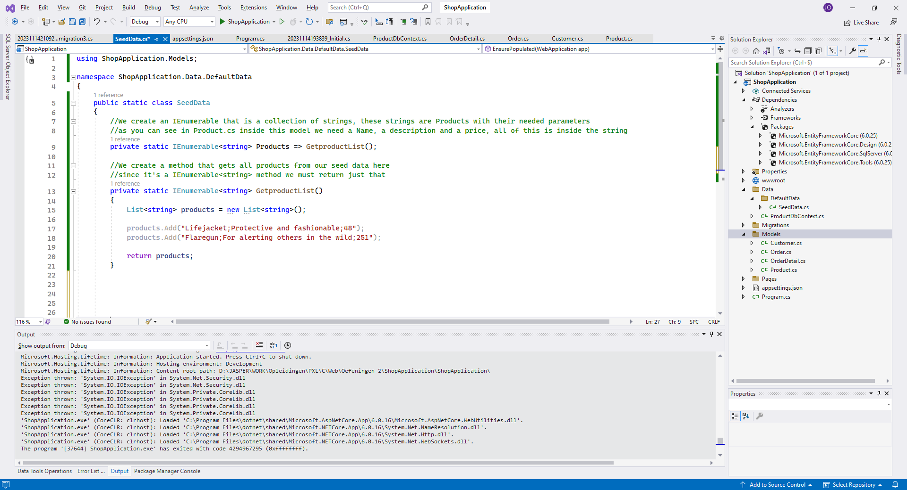
Inside our SeedData we create an Ienumerable field and a Ienumerable method that uses the Ienumerable field

Slide 19
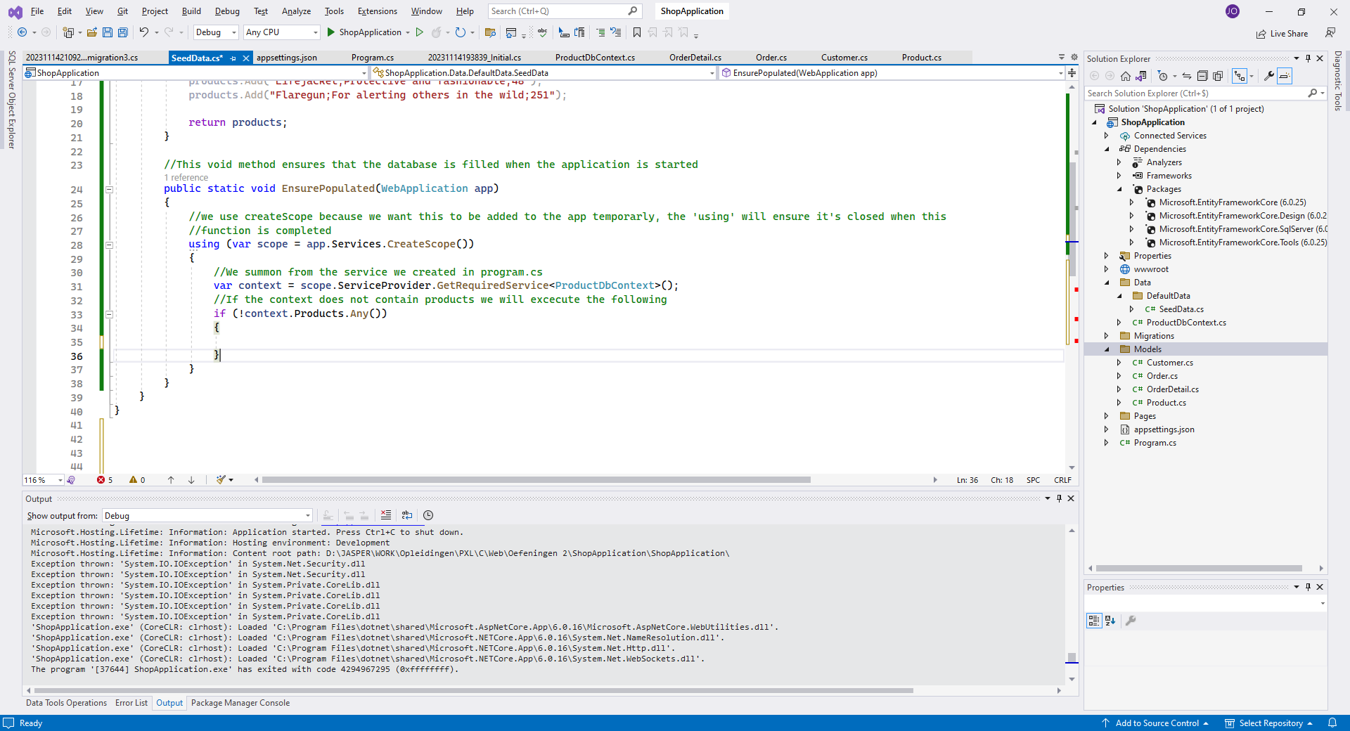
We are still in SeedData

Slide 20
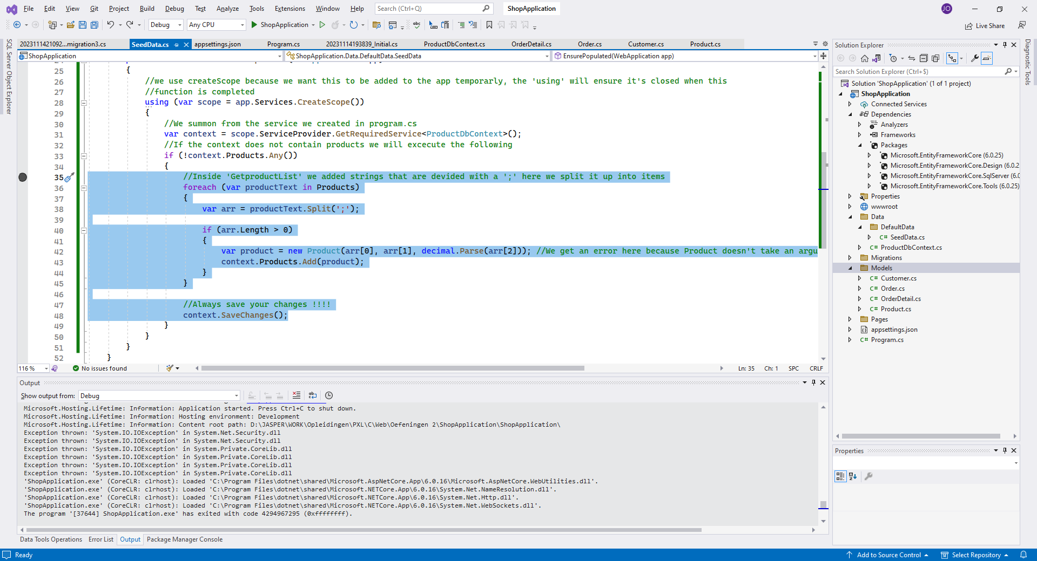
We are still in SeedData

Slide 21
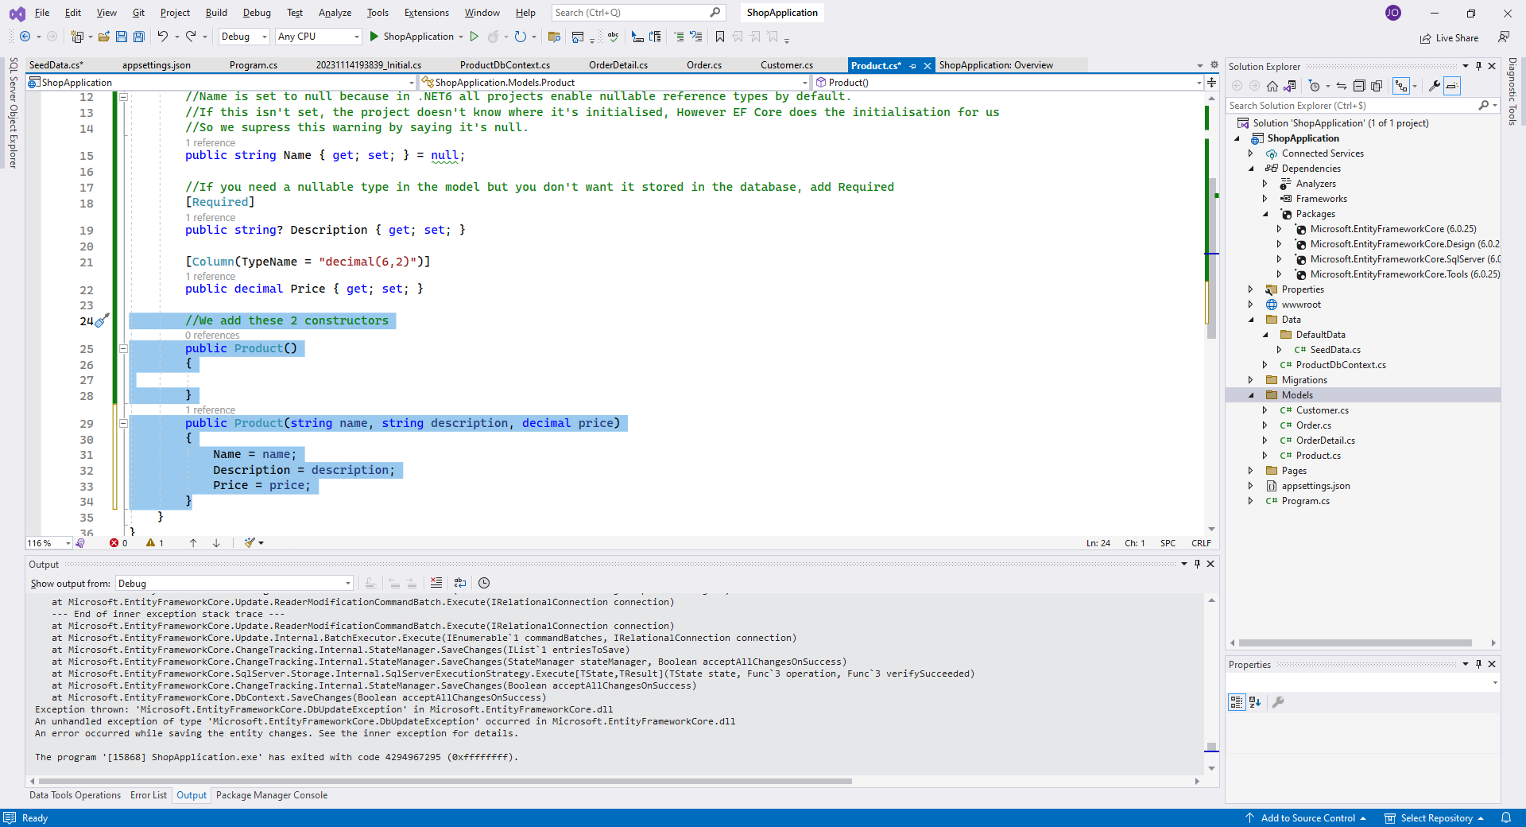
We go back to our Models -> Products and add these 2 constructors
The constructor that takes the arguments is the one we asked for inside our SeedData

Slide 22
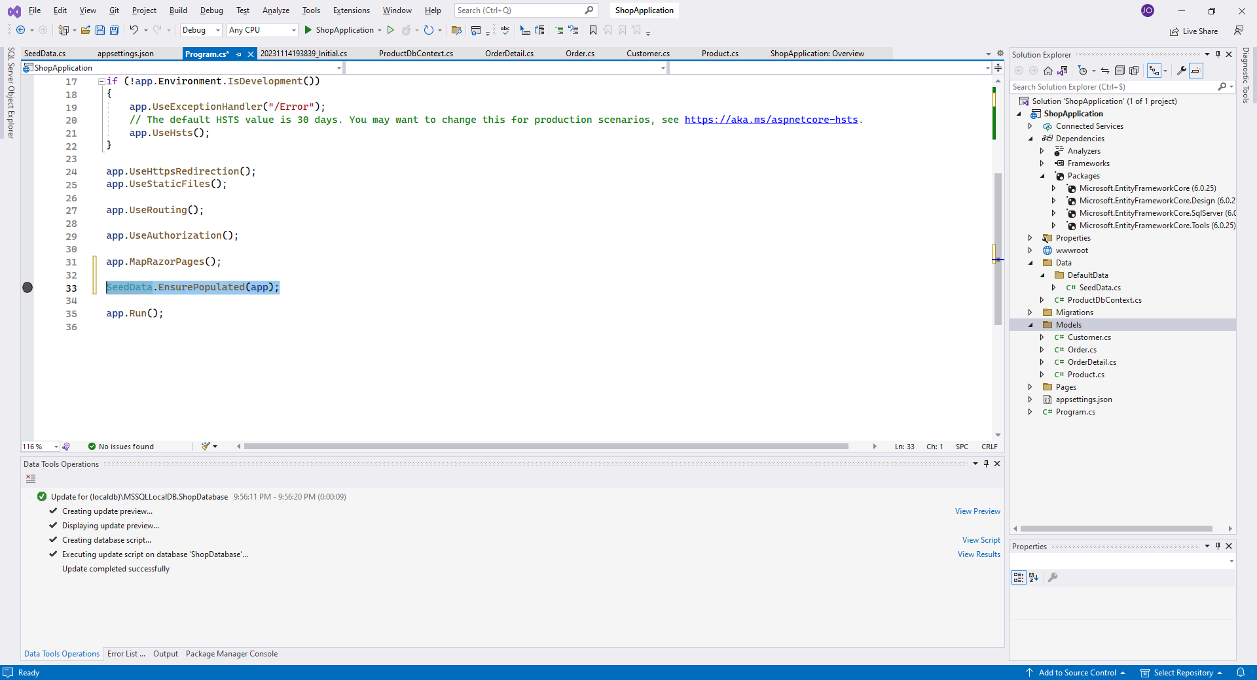
In Program.cs We make sure the method EnsurePopulate is triggered right before the app launches

